Slide 1

Game programming

Slide 2
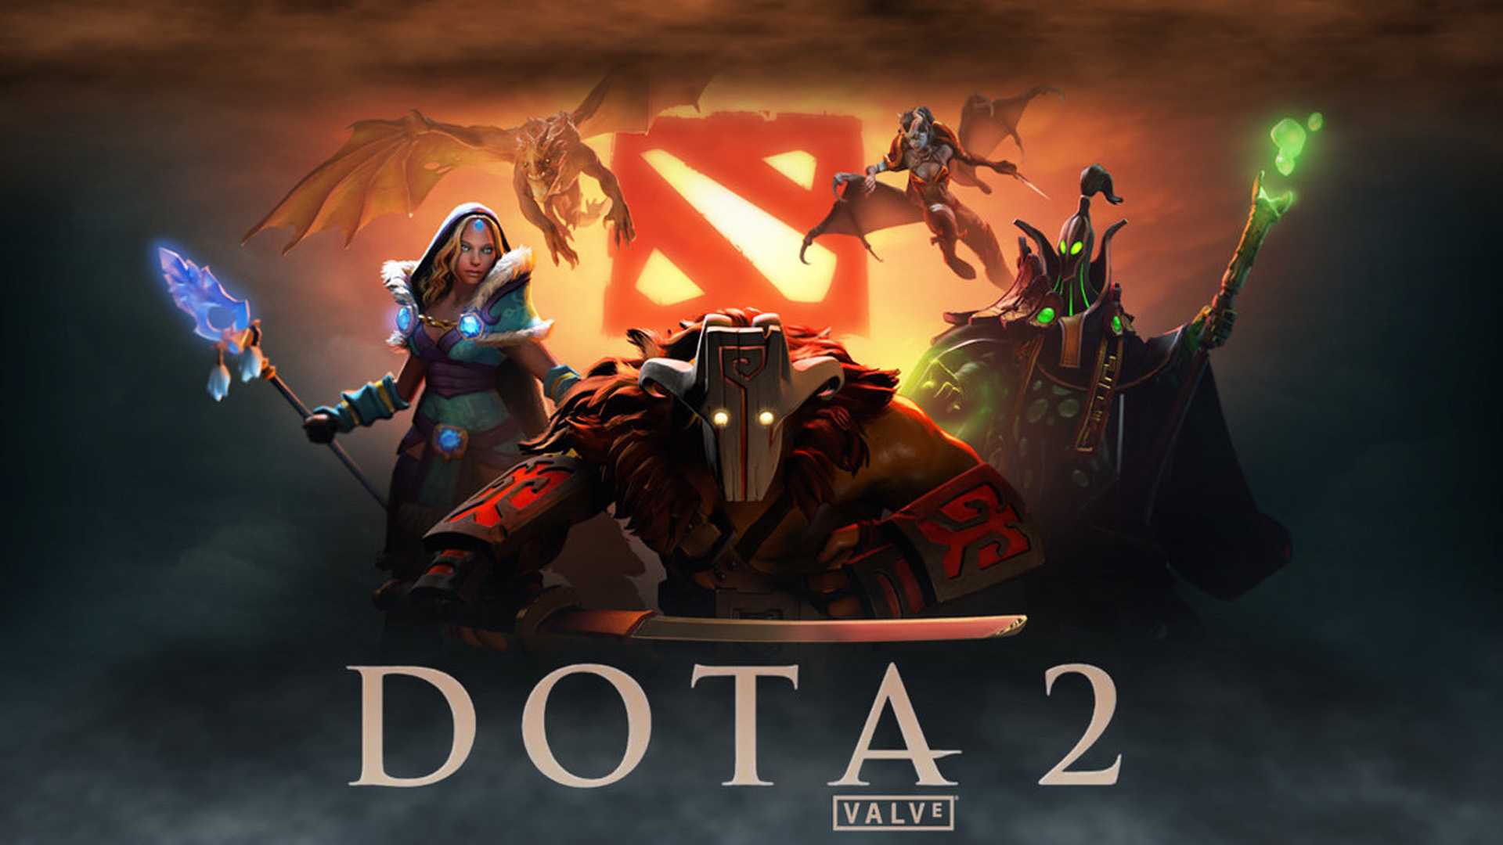
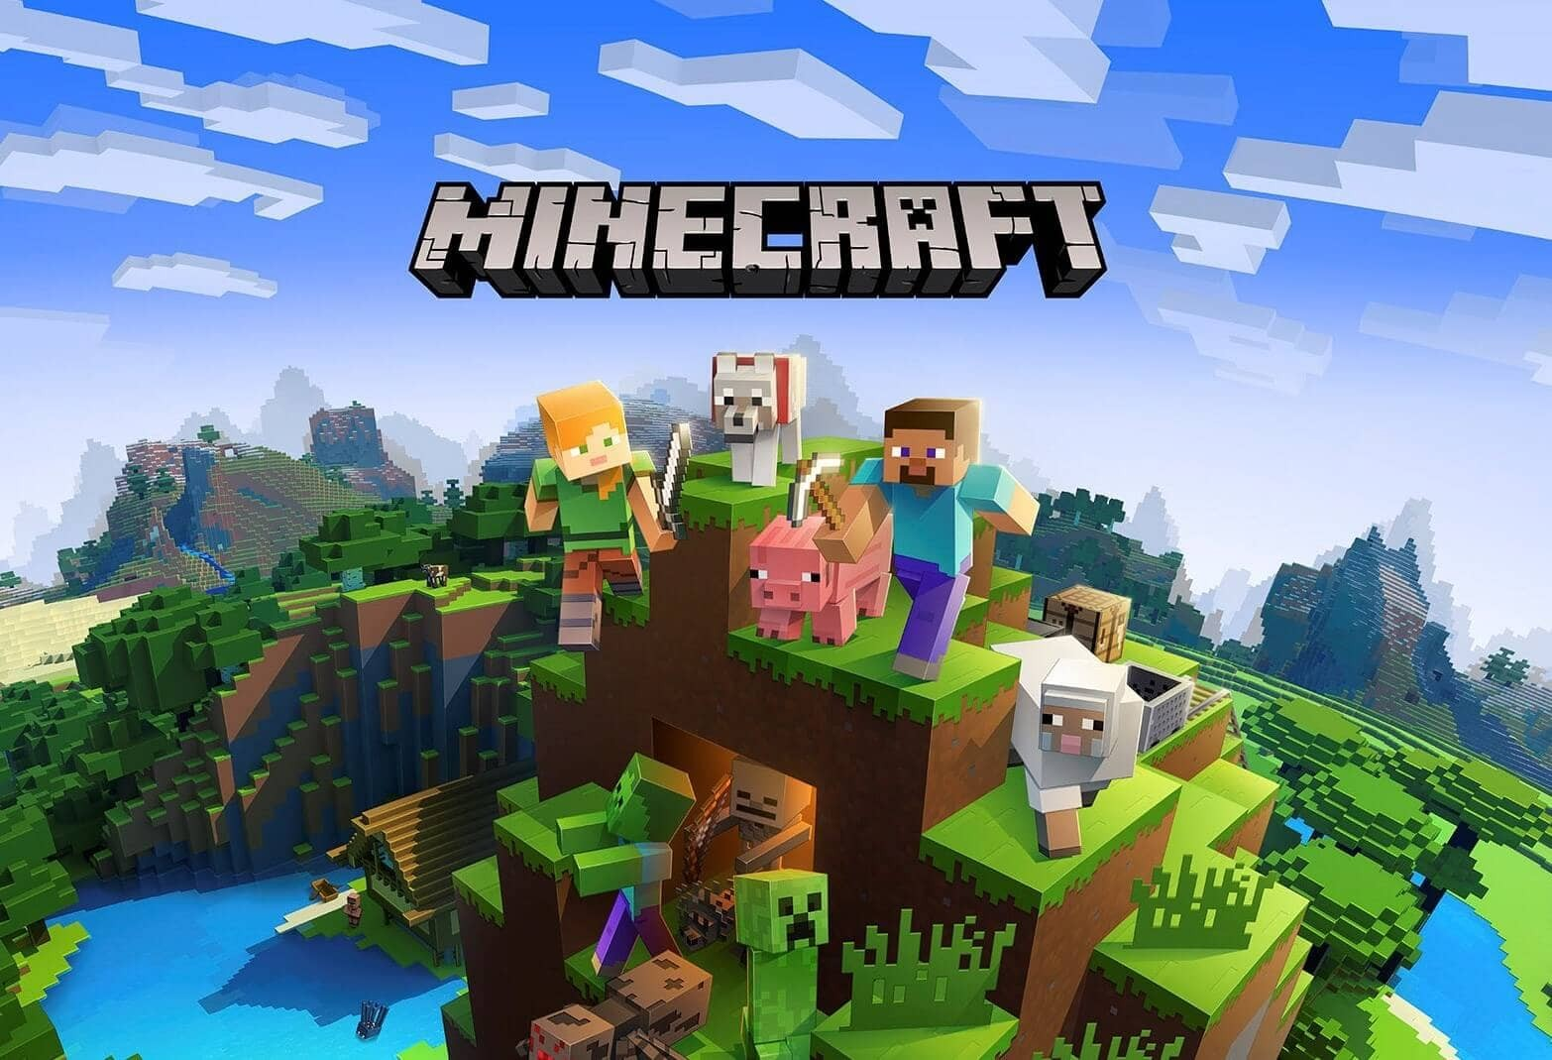

Game programming is the process of creating computer games using program code.
It is a discipline that combines art and science, and allows developers to create interactive worlds that will immerse us in virtual reality.

Slide 3

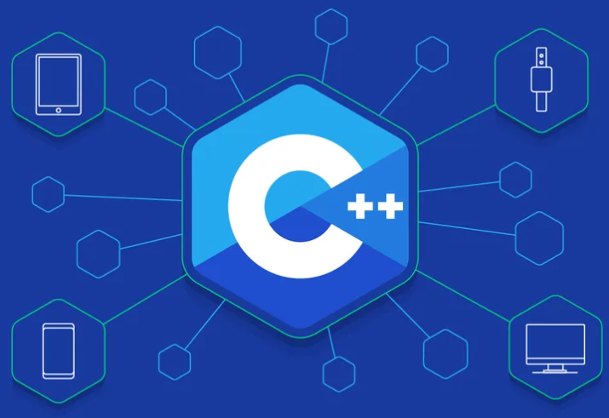
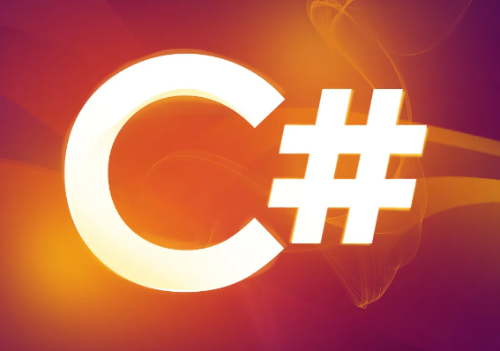



To write a game, you need to have knowledge and experience working with computer programming languages. Some of the most popular programming languages for creating games include Java, C++, C# and Python.
In addition, you need to be able to work in various game development tools, such as Unity and Unreal Engine.

Slide 4
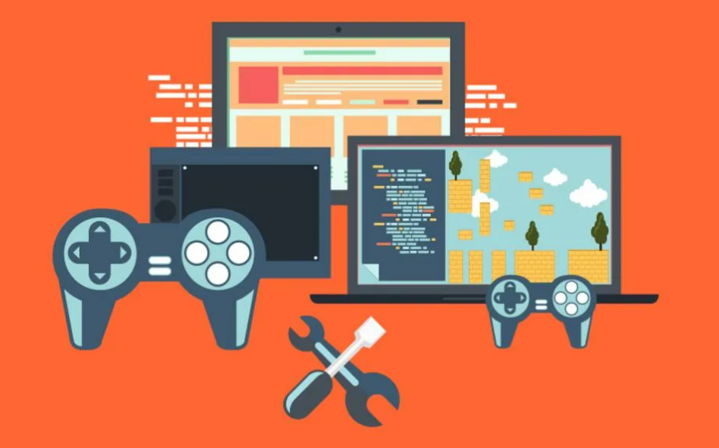

Game programming is a unique type of programming that requires careful planning and design from the developer. The process of creating a game involves several stages, including designing the concept of the game, creating graphics and animations, writing code and testing.

Slide 5
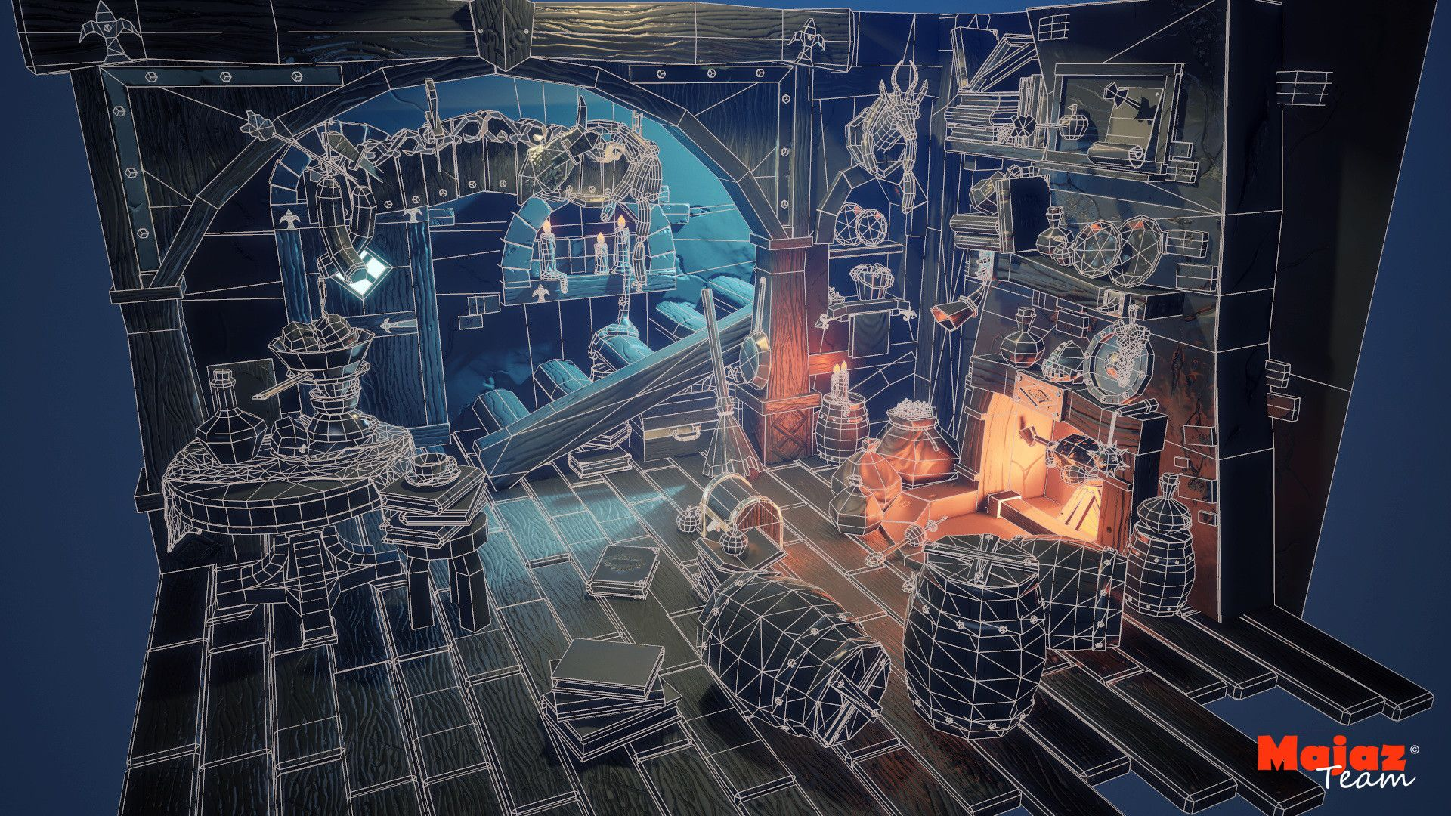

Game Concept Design - This stage is one of the most important in game development, as it defines the concept of the game, its idea, genre, target audience and game mechanics. At this stage, you should compile documentation describing every aspect of the game, including gameplay, levels, characters, interface, etc.
Creating graphics and animation - At this stage, artists and designers develop the visual component of the game, creating concept art, game objects, scenarios and prototypes. They also develop animations and evaluate the work of customers in order to maintain a uniform style and graphic quality.

Slide 6


Writing code - This stage includes the development of software for the game. At this stage, programmers use programming languages such as C++, Java, Python or others to write code to implement the concept of the game. They can also use off-the-shelf game engines like Unity or Unreal Engine to improve and speed up the development process.
Testing - The gameplay must go through a testing phase to detect and fix bugs, performance issues, and gameplay balance. Testing is carried out both manually, testing each function of the game, and automatically, using special software. After testing, the game is being prepared for release or it can be sent for revision, depending on the test results.

Slide 7
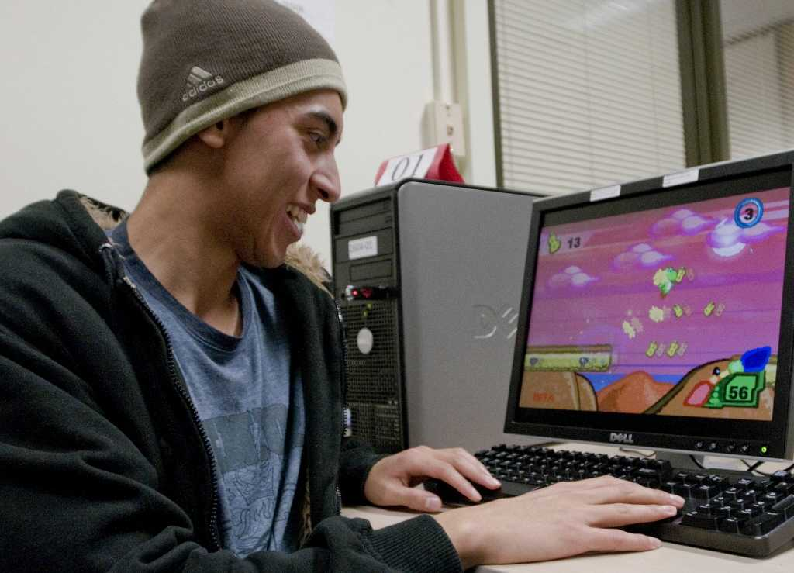

In addition, game programming also involves working with other professionals, such as artists, designers, composers, and testers. This is a process that is closely related to creative thinking and teamwork.

Slide 8
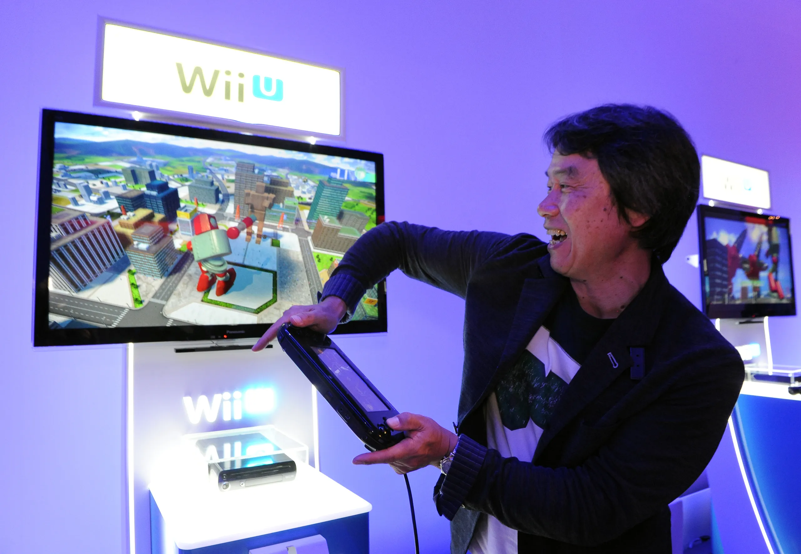

Game programming is an exciting discipline that provides huge opportunities for creativity and the development of various skills. It allows you to create games that can not only occupy players for several hours, but also leave vivid impressions for a lifetime.
Game programming is difficult, but fascinating. If you have a passion for games, as well as an interest in programming, then this is an area that you should definitely explore.

Slide 9
1. What are your favorite games?
2. What stages of game creation do you remember?
3. Which programming languages are the most popular for games?
4. Would you like to develop your own game?

